Slide 1
Trillion Particles, 120,000 cores, and 350 TBs: Lessons Learned from a Hero I/O Run on Hopper
Suren Byna (LBNL – Scientific Data Management group)
Andrew Uselton (NERSC)
Prabhat (LBNL/NERSC)
David Knaak (Cray Inc.)
Helen He (NERSC)

Slide 2
Project and Team Details
Mostly funded by ExaHDF5 project
Team:
Application Scientists: H. Karimabadi (UCSD), W. S. Daughton (LANL), V. Roytershteynz (UCSD)
Colleagues: J. Chou, K. Lin (National Tsinghua Univ., Taiwan), O. Rübel, E. W. Bethel, M. Howison, A. Shoshani, K. Wu (LBNL), Q. Koziol (HDF5)
A lot of help from NERSC and Cray
NERSC: Tina Butler, Katie Antypas, Francesca Verdier, Woo-Sun Yang, and Harvey Wasserman.
Cray: Steve Luzmoor, Terence Brewer, Randell Palmer, Bill Anderson, Mark Pagel, and Steven Oyanagi

Slide 3
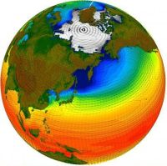
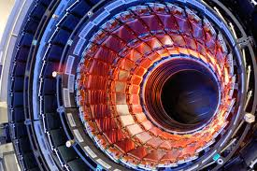
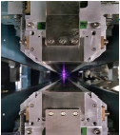
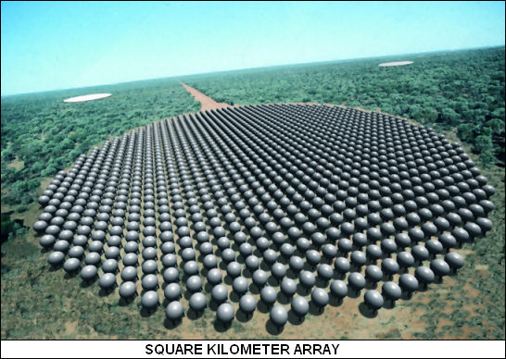
Data Explosion in Scientific Computing
Modern scientific discoveries are driven by data
By 2020, climate data is expected to be hundreds of exabytes or more
LHC experiments produce petabytes of data per year
Light source experiments at LCLS, ALS, SNS, etc. produce tens of TB/day
1 Exabyte per a day (10 petabytes every hour)
Storing, analyzing, and visualizing large data are big challenges

Slide 4
Data Management Challenges
A scalable I/O strategy for storing massive data output
In situ analysis works well when analysis tasks are known a priori
Many scientific applications require to store datasets for exploratory analysis
A scalable strategy for conducting analysis on these datasets
Sift through large amounts of data looking for useful information
A visualization strategy for examining the datasets
Display information that makes sense
VPIC is a simulation that pushes the limits of data management tools on large supercomputers

Slide 5
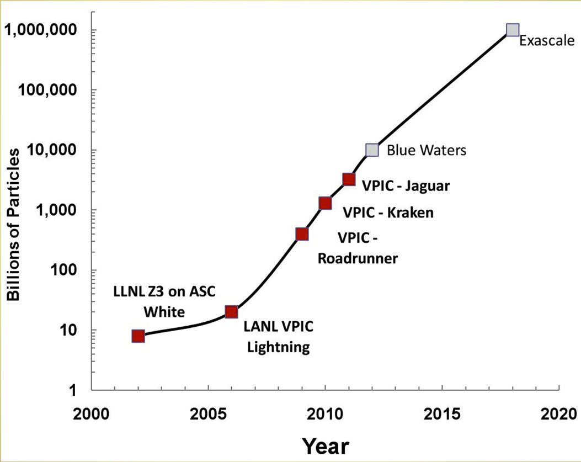
The application: Vector Particle-in-Cell (VPIC) Simulation
A state-of-the-art 3D electromagnetic relativistic PIC plasma physics simulation
It is an exascale problem and scales well on large systems
An open boundary VPIC simulation of magnetic reconnection (Space weather)
NERSC Hopper Supercomputer
VPIC-Hopper
6,384 compute nodes; 2 twelve-core AMD 'MagnyCours' 2.1-GHz processors per node; 32 GB DDR3 1333-MHz memory per node; Interconnect with a 3D torus topology
Lustre parallel file system with 156 OSTs at a peak BW of 35 GB/s

Slide 6

X1.7-Solar Flare of May 12, 2013
http://www.space.com/20621-solar-maximum-sun-storm-photos-2013.html
http://www.youtube.com/watch?v=5LVKOPMEnqg

Slide 7

The application: Vector Particle-in-Cell (VPIC) Simulation
March 1989: A power blackout in Canada affected 6 million people.
October-November 2003: Solar panels fail on the $450 million Midori 2 research satellite, and astronauts take cover in the International Space Station.
June 2011: Airlines report disruption of high-frequency radio communications near the Arctic.
Notes:
March 1989: A power blackout in Canada affected 6 million people.
October-November 2003: Solar panels fail on the $450 million Midori 2 research satellite, and astronauts take cover in the International Space Station.
June 2011: Airlines report disruption of high-frequency radio communications near the Arctic.

Slide 8
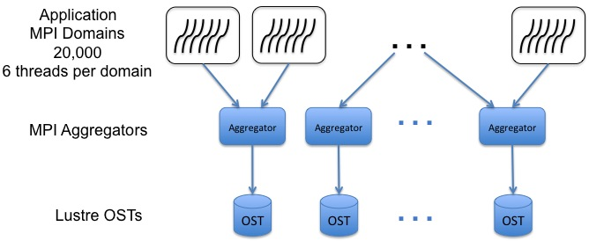
VPIC Trillion Particle Simulation setup
20,000 MPI processes (MPI domains) using 120,000 cores
Each MPI process writes ~51 Million (±15%) particles
Each particle has 8 variables
Lustre-aware MPI-IO implementation
MPI collective buffer size is equal to the stripe size
Number of MPI aggregators is equal to the stripe count
Particle dataset size varies (30TB to 43TB) per time step – A total of 350 TB data + 150 TB checkpoint data

Slide 9
Science Questions
Understanding physical mechanisms responsible for producing magnetic reconnection in a collisionless plasma
Analysis of highly energetic particles
Are the highly energetic particles preferentially accelerated along the magnetic field?
What is the spatial distribution of highly energetic particles?
Agyrotropy: A quantitative measure of the deviation of the distribution from cylindrical symmetry about the magnetic field
What are the properties of particles near the reconnection hot-spot (the so-called X-line)?
What is the degree of agyrotropy in the spatial vicinity of the X-line?
Notes:
Understanding physical mechanisms responsible for producing magnetic reconnection in a collisionless plasma is important to characterize the symmetry properties of the particle distribution

Slide 10
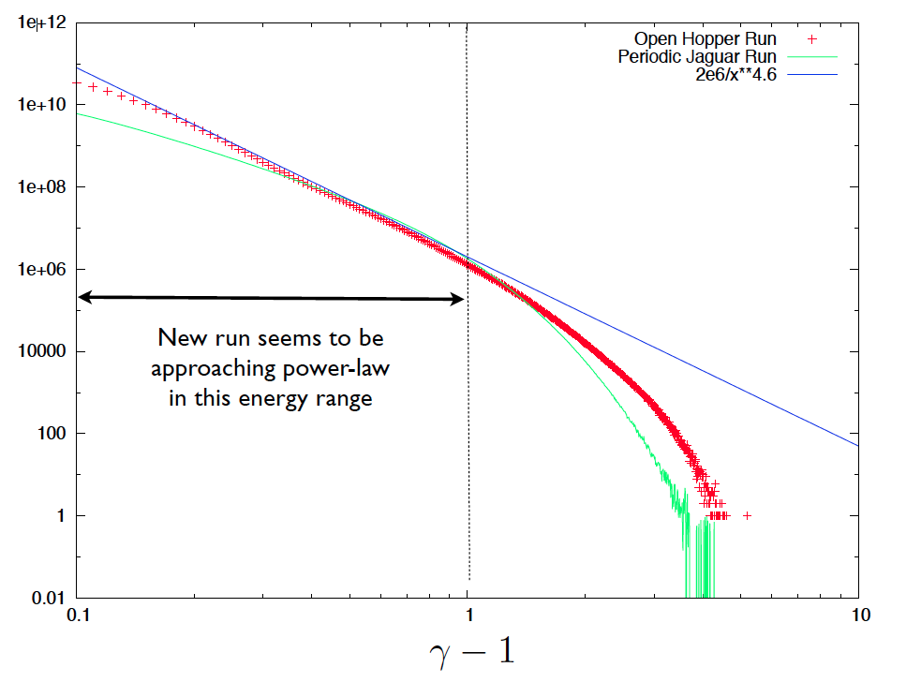
Science Impact: Multiple discoveries in plasma physics
Preferential acceleration along magnetic field
Energetic particles are correlated with flux ropes
Discovered power-law distribution in energy spectrum
Discovered agyrotropy near the reconnection hot-spot

Slide 11
Expected challenges in running the application
Scheduling a large job that would take ~80% of compute nodes
Queue time may be longer: reg_xbig queue, which is turned on at 9PM on Fridays
Need to split the 36 hr. simulation and checkpoint often
Lustre file system may be stressed due to large volume of data produced
But…
There were a few more lessons we learned

Slide 12
Lessons Learned
Collective writes to a single shared HDF5 file can work as well as file-per-process writes
Tuning multiple layers of parallel I/O subsystem is a challenging task
Advance verification of file system hardware is important for obtaining peak performance
Advance verification of available resources for memory-intensive applications is important
Scalable tools are required for diagnosing software and hardware problems before running applications using 100k cores

Slide 13
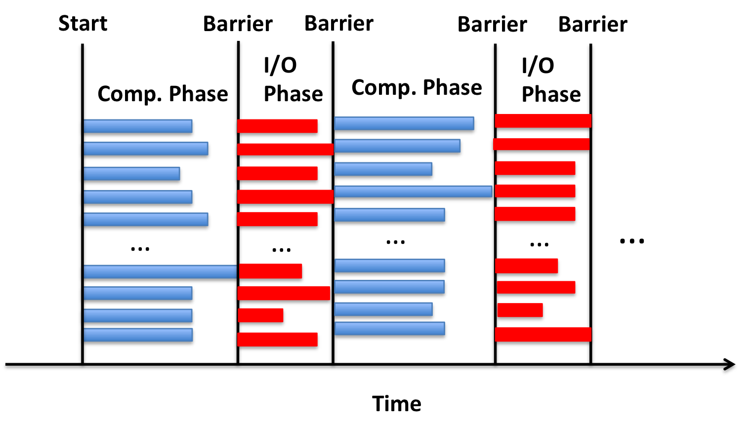
Lesson 1: Parallel HDF5 works – VPIC I/O pattern
I/O of VPIC follows a banded pattern
Two file writing strategies
File per process model
Shared file with HDF5 and H5Part

Slide 14
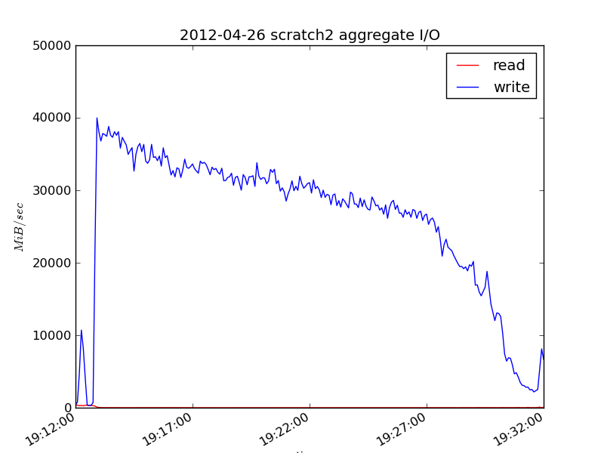
Lesson 1: Parallel HDF5 works – File-per-process
Performance of 20,000 files with a combined size of ~30TB
Lustre Monitoring Tool
Load imbalance and the last OST finishing writing dictate performance
I/O rate: 27,007 MB/s

Slide 15
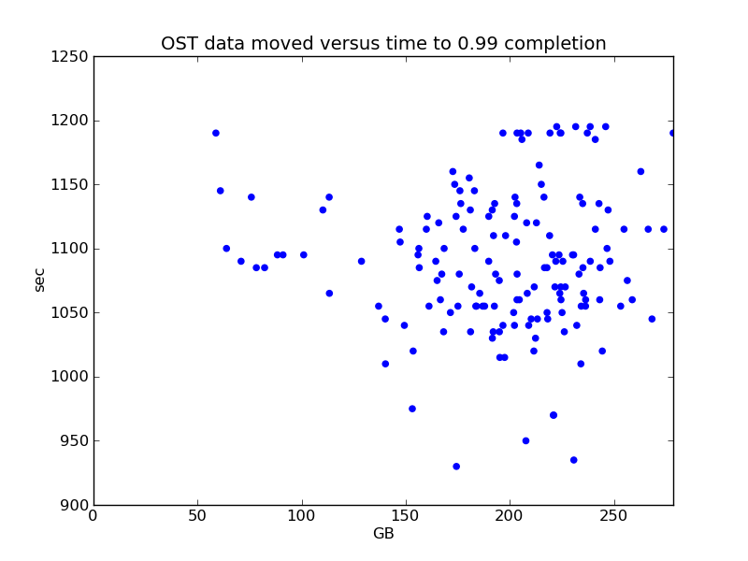
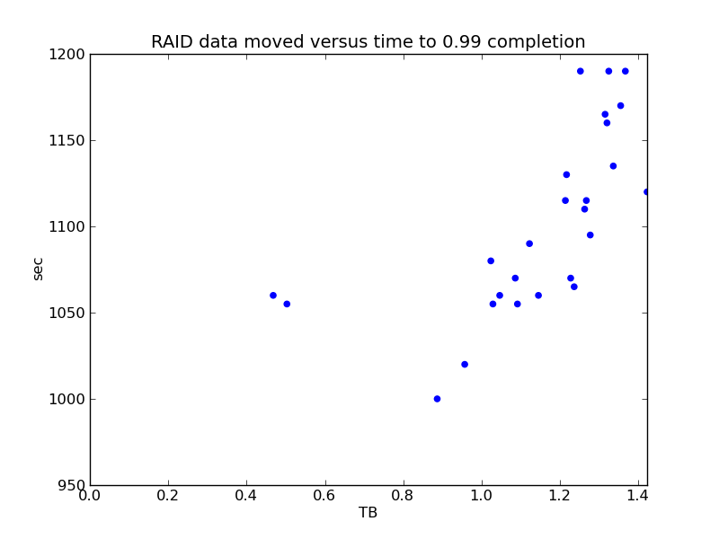
Lesson 1: Parallel HDF5 works – File-per-process
Uneven load leads to uneven completion times
Problems with file-per-process model
Too many files – 20,000 files per time step in our case
Dictates the concurrency of subsequent stages in the analysis pipeline
Many data management and visualization tools only support standard data formats, such as HDF5 and NetCDF

Slide 16
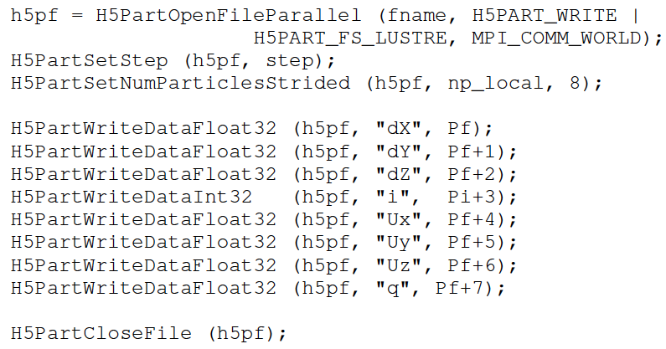
Lesson 1: Parallel HDF5 works – HDF5 and H5Part
http://vis.lbl.gov/Research/H5Part/

Slide 17
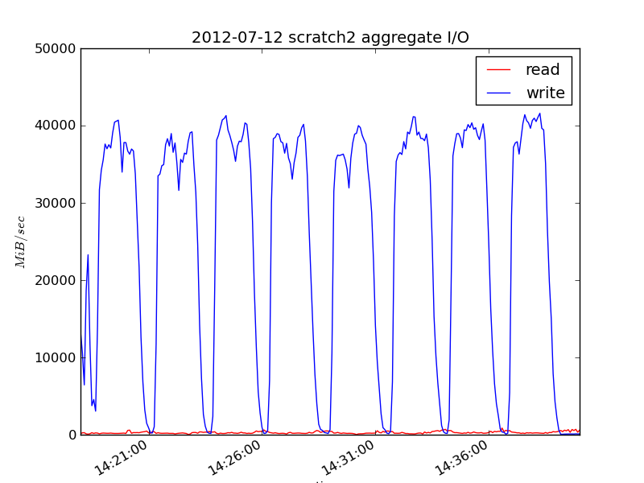
Lesson 1: Parallel HDF5 works – HDF5 and H5Part
Performance of writing one ~31 TB particle file
I/O rate: 27,035 MB/s
Need for rendezvous after writing each variable, due to H5Part and HDF5 interactions

Slide 18
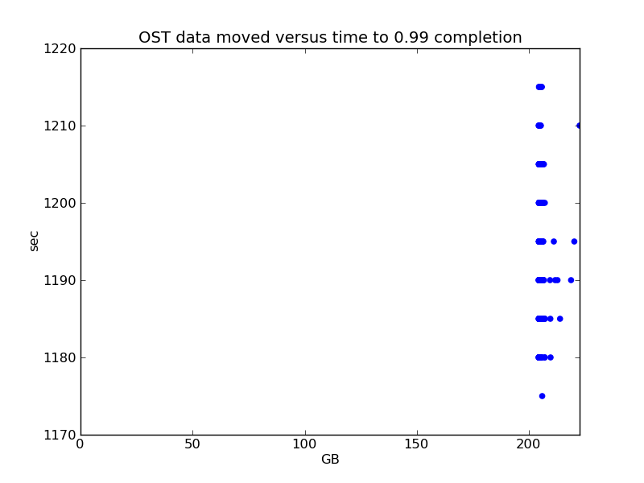
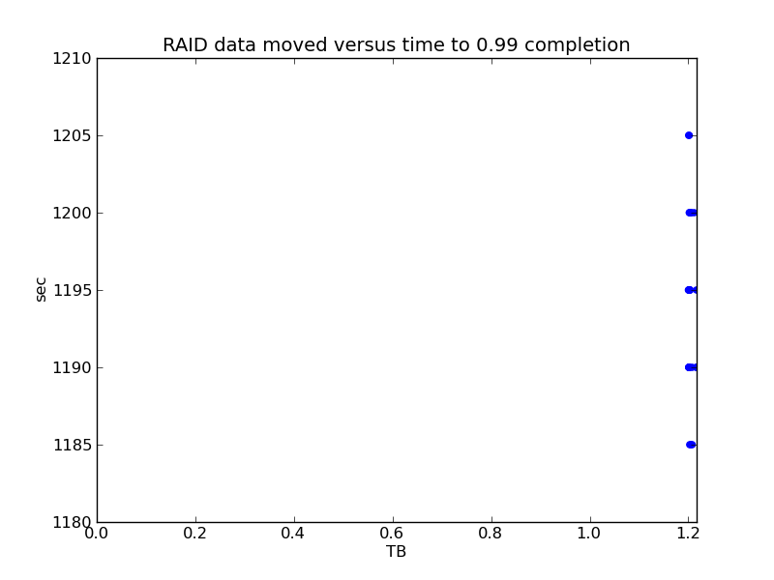
Lesson 1: Parallel HDF5 works – Load balance
Uniform load across the 156 OSTs and the RAIDs
Some variability due to collective operations after each variable dump
Overall, I/O performance of parallel HDF5 compares favorably with that of file-per-process
HDF5 and Lustre performance was not automatic, but needed some tuning
Notes:
Writing large file is not ideal as well because managing a 40TB file is not easy. We are working on creating subfiles that are a bit more manageable.

Slide 19
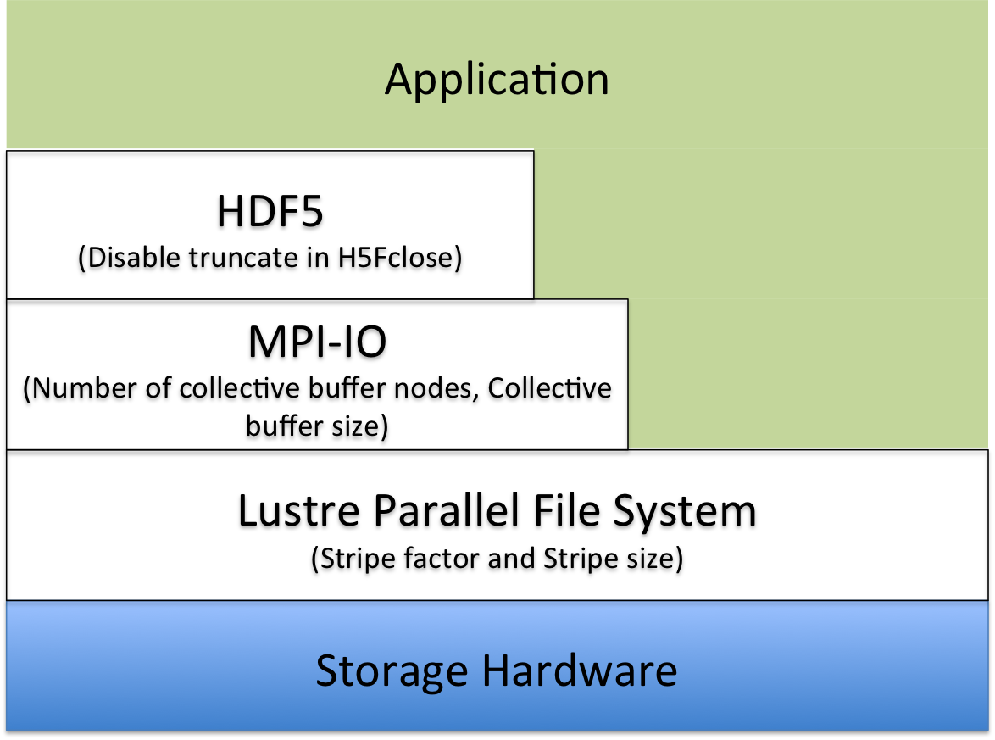
Lesson 2: Tuning parallel I/O is a challenge, but not impossible – I/O Stack
Layers of parallel I/O software stack offer various tunable parameters
Finding the right tunable parameters is a challenge
To search the parameter space, we extracted the I/O kernel of VPIC
VPIC-IOBench

Slide 20
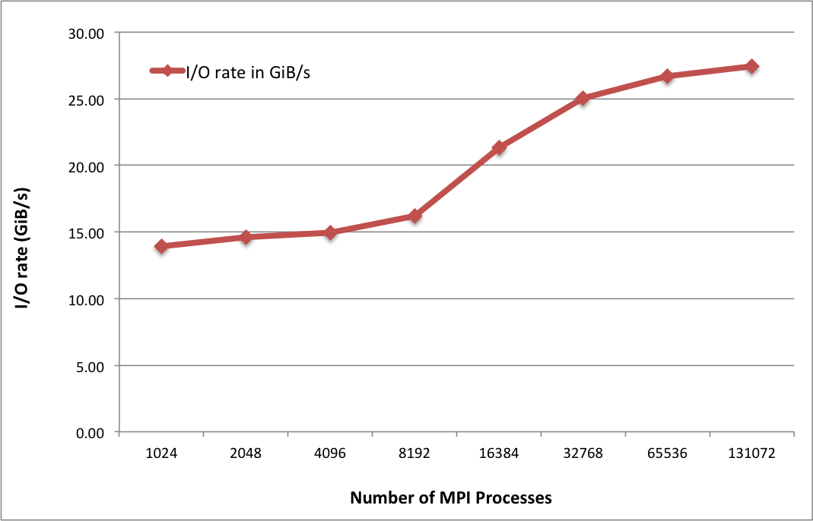
Lesson 2: Tuning parallel I/O is a challenge, but not impossible – Lustre and MPI-IO tuning
Lustre stripe count and stripe size
Varied stripe count from 64 to 156 and stripe size from 1MB to 1GB
Chose stripe count of 144 and stripe size of 64MB
Lustre-aware MPI-IO collective buffering on Hopper uses CB2 algorithm
Number of collective buffering aggregator nodes is equal to the stripe count
Size of collective buffer is equal to the stripe size

Slide 21
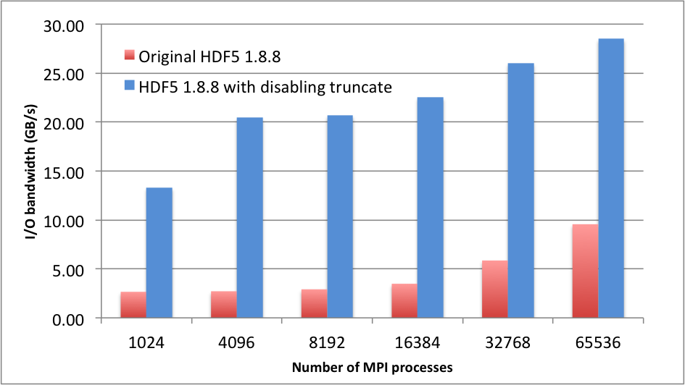
Lesson 2: Tuning parallel I/O is a challenge, but not impossible – HDF5 truncate
HDF5 file close function verifies the size of the file matching with its allocated size to detect any external modification or corruption
This is an expensive operation because of its collective nature
Modified HDF5 to disable this “truncate” operation and achieved 3-5X performance improvement
Notes:
A better alternative to simply disabling the truncate call is to track the valid section of the file by adding more metadata to the file format. This optimization will soon be a part of upcoming HDF5 release allowing all parallel HDF5 applications to more productively use HDF5 for I/O.

Slide 22
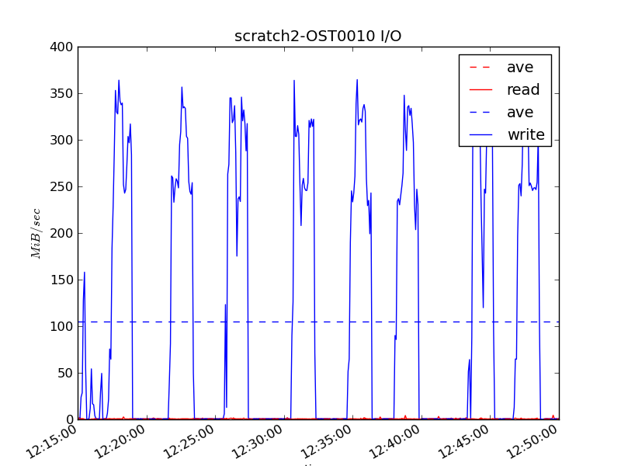
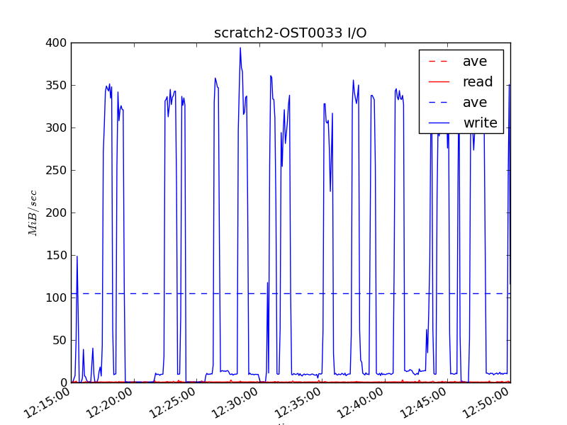
Lesson 3: Advance verification of file system software is important – OSTs behaving badly
Early runs obtained a 60% of peak bandwidth
To achieve peak performance, each OST needs to be performing at 250 MB/s

Slide 23
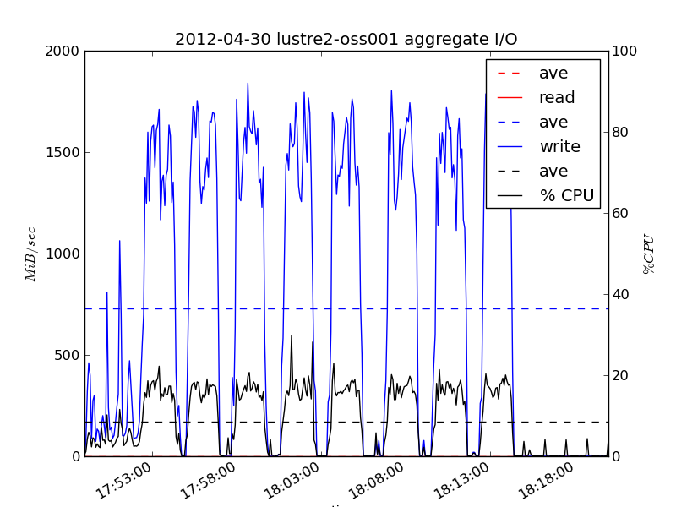
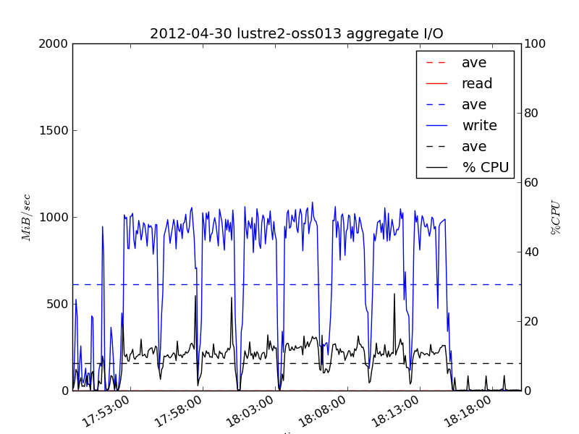
Lesson 3: Advance verification of file system software is important – OSSs behaving badly
Early runs obtained a 60% of peak bandwidth
To achieve peak performance, each OST needs to be performing at 250 MB/s
Notes:
There was coincidentally a failed-over RAID controller pair, though the connection between that and the slower OSSs is not clear. Again, the issue resolved itself before the next run and subsequent runs were able to reduce dump time to around 20 minutes.

Slide 24
Lesson 4: Advance verification of resources for memory intensive apps is important
On most nodes, Hopper has 32 GB memory
Some nodes have 64 GB
Total memory of 5,000 nodes: ~156 TB
VPIC memory footprint is ~142 TB
Translates to ~29 TB on each node when the simulation uses 5,000 nodes
90% of the memory on each node
Considering some lightweight OS tasks running on the nodes, 90% of memory requirement puts significant pressure
Experienced OOM error from one node crashing the application

Slide 25
Lesson 4: Advance verification of resources for memory intensive apps is important - Solution
Used a combination of tools to verify memory availability before each run and after dumping large particle data
Node Health Checker (NHC)
Free Memory Check to verify the available free memory
“Admindown” nodes with less than 29 GB free memory
Developed a Perl script that reads the free memory information from /proc/buddyinfo on all the nodes in allocation
Manually sorted and verified the free memory

Slide 26
Lesson 5: Scalable tools are required for diagnosing SW and HW problems
It can be time consuming and tedious for a user to verify system health prior to a large run
Scalable tools can help diagnosing the SW and HW problems
Some tools exist, but need streamlining the process of verification
Scalable computation and memory resource checker
With the help of Cray and NERSC staff, used NHC and “xtprocadmin” to verify the current status of nodes
Used NHC and local script to check memory status

Slide 27
Lesson 5: Scalable tools are required for diagnosing SW and HW problems
Scalable I/O subsystem checker
Used manual I/O tuning to identify good set of optimization parameters
Our work in progress to identify tuned set of parameters at each layer of the parallel I/O stack
Scalable Runtime I/O Monitor
Typically, many applications idle during I/O wasting CPU resources
Even one sluggish OST can increase the waste significantly
Lustre Monitoring Tool (LMT) was very helpful; OSTs of bad behavior had to be found manually in postmortem – Any better and pro-active solutions??

Slide 28
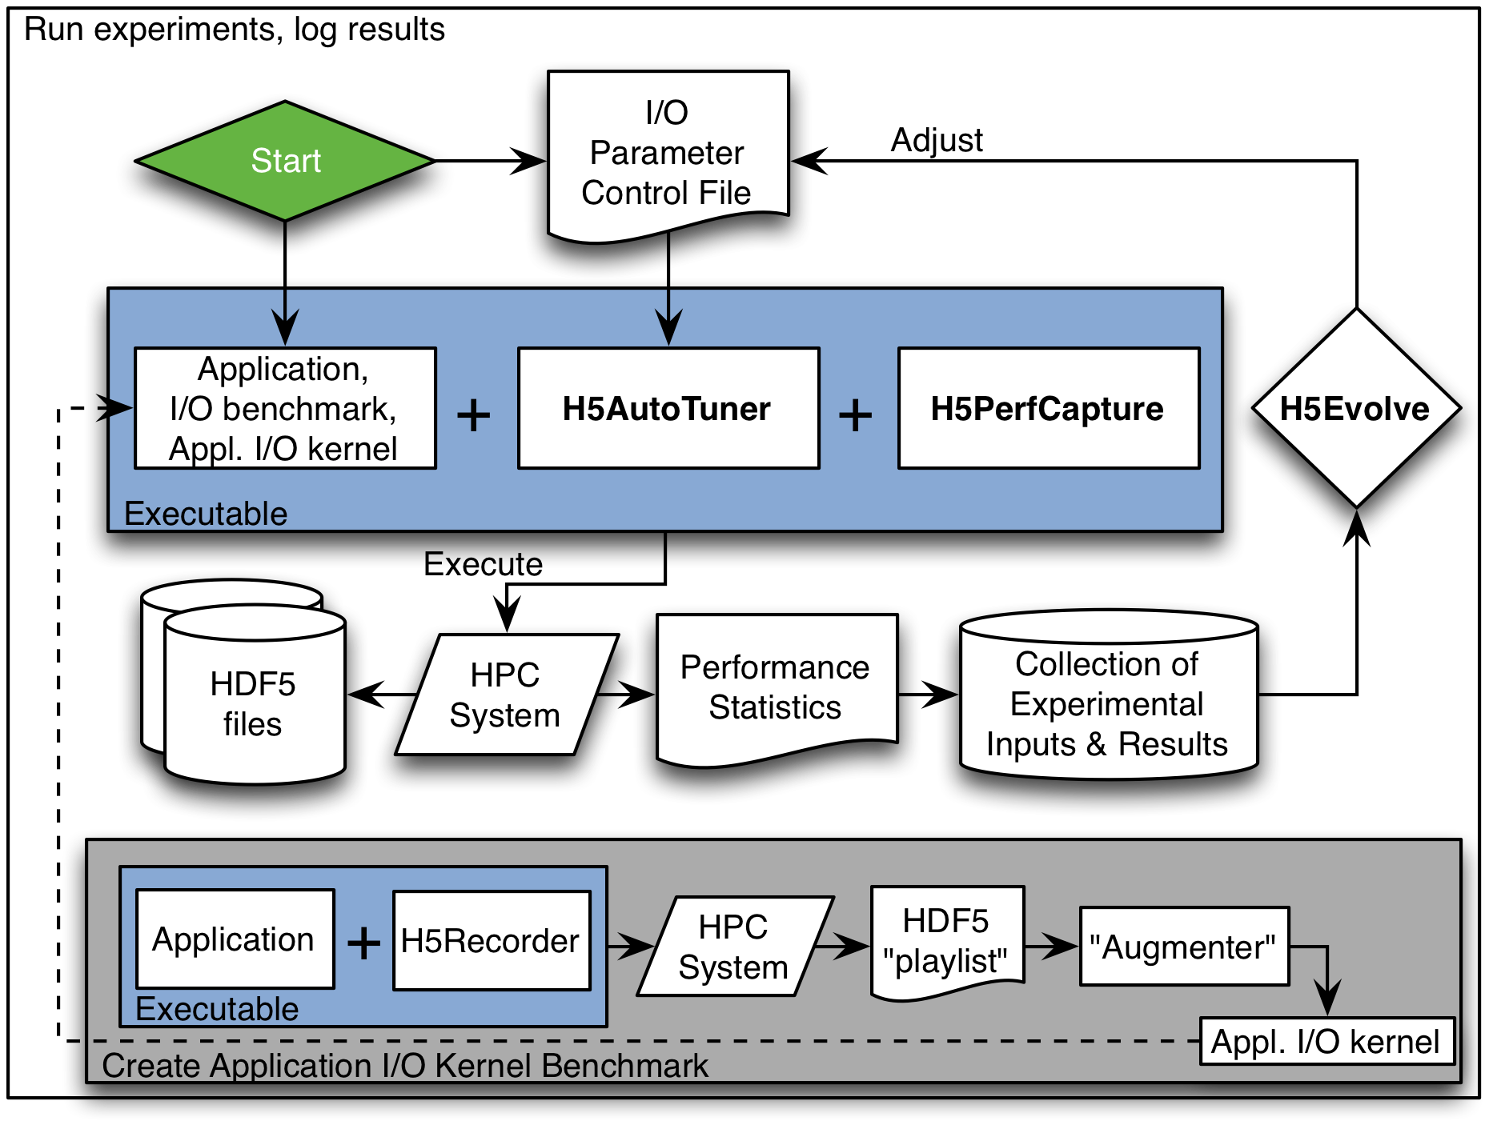
I/O Auto-tuning framework
H5Tuner uses genetic algorithms to traverse the I/O tunable parameter space intelligently and pick the best performing tunable parameter sets
Identify I/O pattern and map the pattern with parameter sets
Initial results are encouraging
2X to 38X on different architectures, multiple applications, and different concurrencies

Slide 29
Lesson 5: Scalable tools are required for diagnosing SW and HW problems
Scalable I/O subsystem checker
Used manual I/O tuning to identify good set of optimization parameters
Our work in progress to identify tuned set of parameters at each layer of the parallel I/O stack
Scalable Runtime I/O Monitor
Typically, many applications idle during I/O wasting CPU resources
Even one sluggish OST can increase the waste significantly
Lustre Monitoring Tool (LMT) was very helpful; OSTs of bad behavior had to be found manually in postmortem – Any better and pro-active solutions??
Notes:
LMT or similar I/O monitoring tools that we can see performance to identify bottlenecks are needed.

Slide 30
Lessons Learned
Collective writes to a single shared HDF5 file can work as well as file-per-process writes
Tuning multiple layers of parallel I/O subsystem is a challenging task
Advance verification of file system hardware is important for obtaining peak performance
Advance verification of available resources for memory-intensive applications is important
Scalable tools are required for diagnosing software and hardware problems before running applications using 100k cores

Slide 31
Future
More large scale runs and fixing parallel I/O problems
ExaHDF5
I/O Auto-tuning
New features: Asynchronous execution, in situ support, performance scaling
Scientific Data Services
A new data management system
Best of parallel file systems and database management systems
Features: Transparent and live data reorganization, querying support, indexing, in situ runtime, simulation and experimental data validation, etc.
Performance debugging needs
I/O performance monitoring
Close collaboration with NERSC

Slide 32




Thanks!
Contact: Suren Byna: <SByna@lbl.gov>
Prabhat: <Prabhat@lbl.gov>
Advanced Scientific Computing Research (ASCR) for funding the ExaHDF5 Project; Program Manager: Lucy Nowell
Application Scientists: H. Karimabadi, W. S. Daughton, V. Roytershteynz,
Colleagues: J. Chou, O. Rübel, E. W. Bethel, M. Howison, K.-J. Hsu, K.-W. Lin, A. Shoshani, K. Wu, Q. Koziol (HDF5), J. Shalf
NERSC: Tina Butler, Katie Antypas, Francesca Verdier, Woo-Sun Yang, and Harvey Wasserman.
Cray: Steve Luzmoor, Terence Brewer, Randell Palmer, Bill Anderson, Mark Pagel, and Steven Oyanagi

